Slide 1

Advanced React Concepts
Pravesh Choudhary
Tech Lead (MXP) at Yara AgTech

Slide 2

Prerequisites
Node (v16 or greater) and NPM installed
Code editor IDE – vs-code, sublime or any text editor
Knowledge of HTML, CSS and JavaScript basics
Knowledge of basics of React

Slide 3

Topics
Using an API with React
Communication using React Context
Other React Hooks
Dive into Redux Toolkit
Redux Toolkit Query

Slide 4

Using an API with React

Slide 5
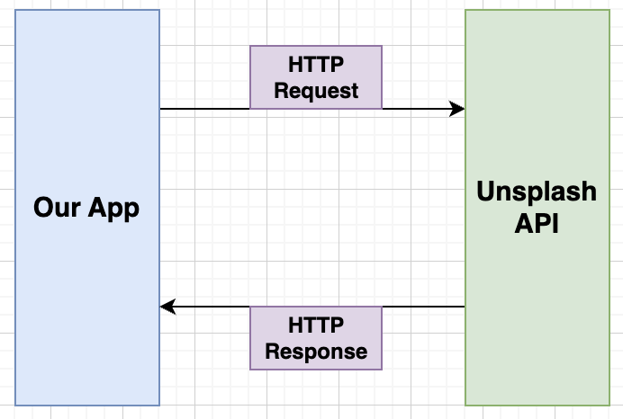
API requests

Slide 6
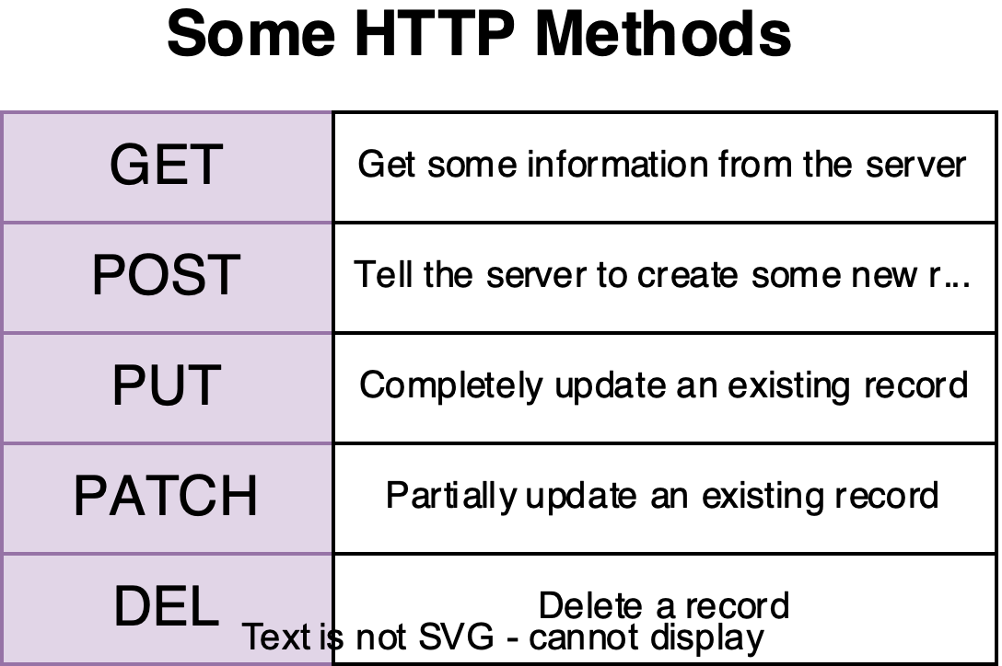

Slide 7
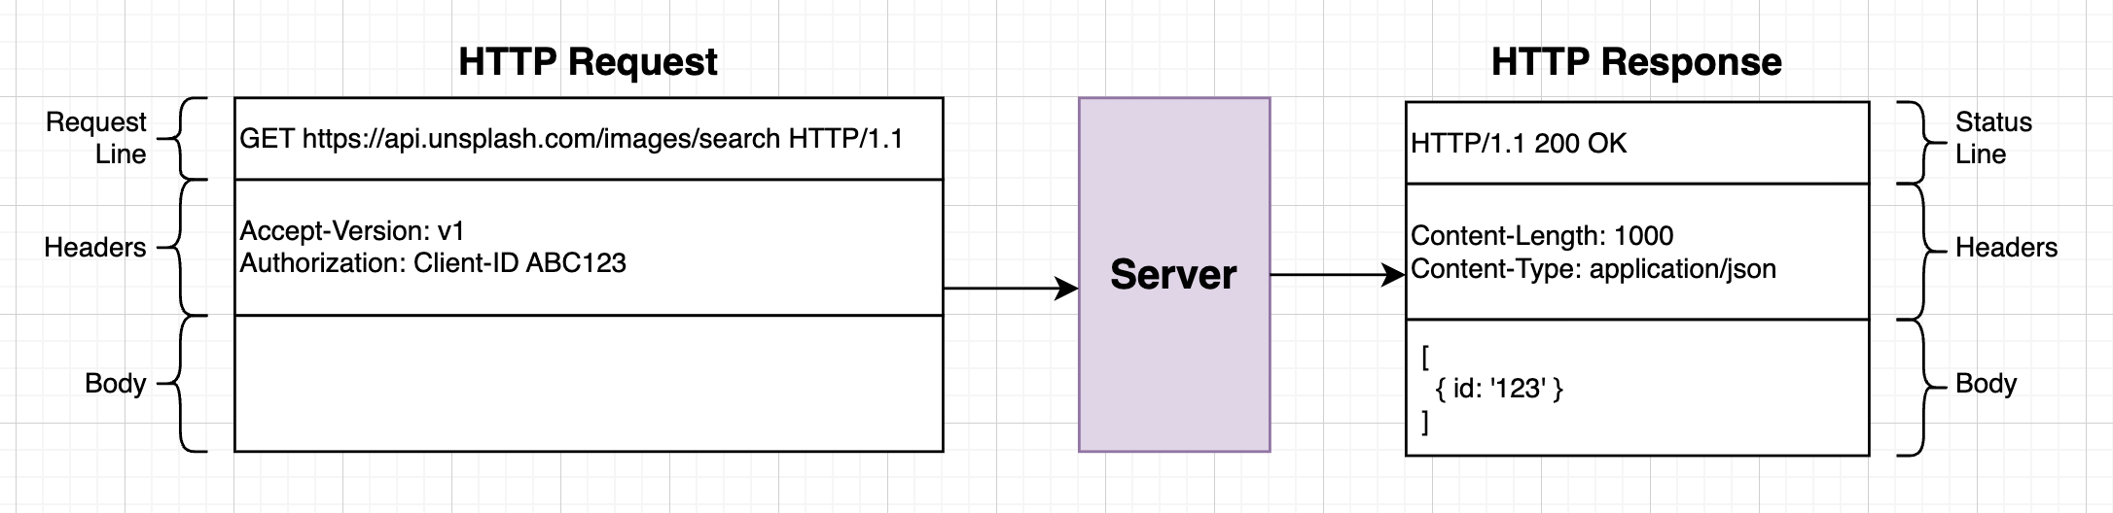

Slide 8
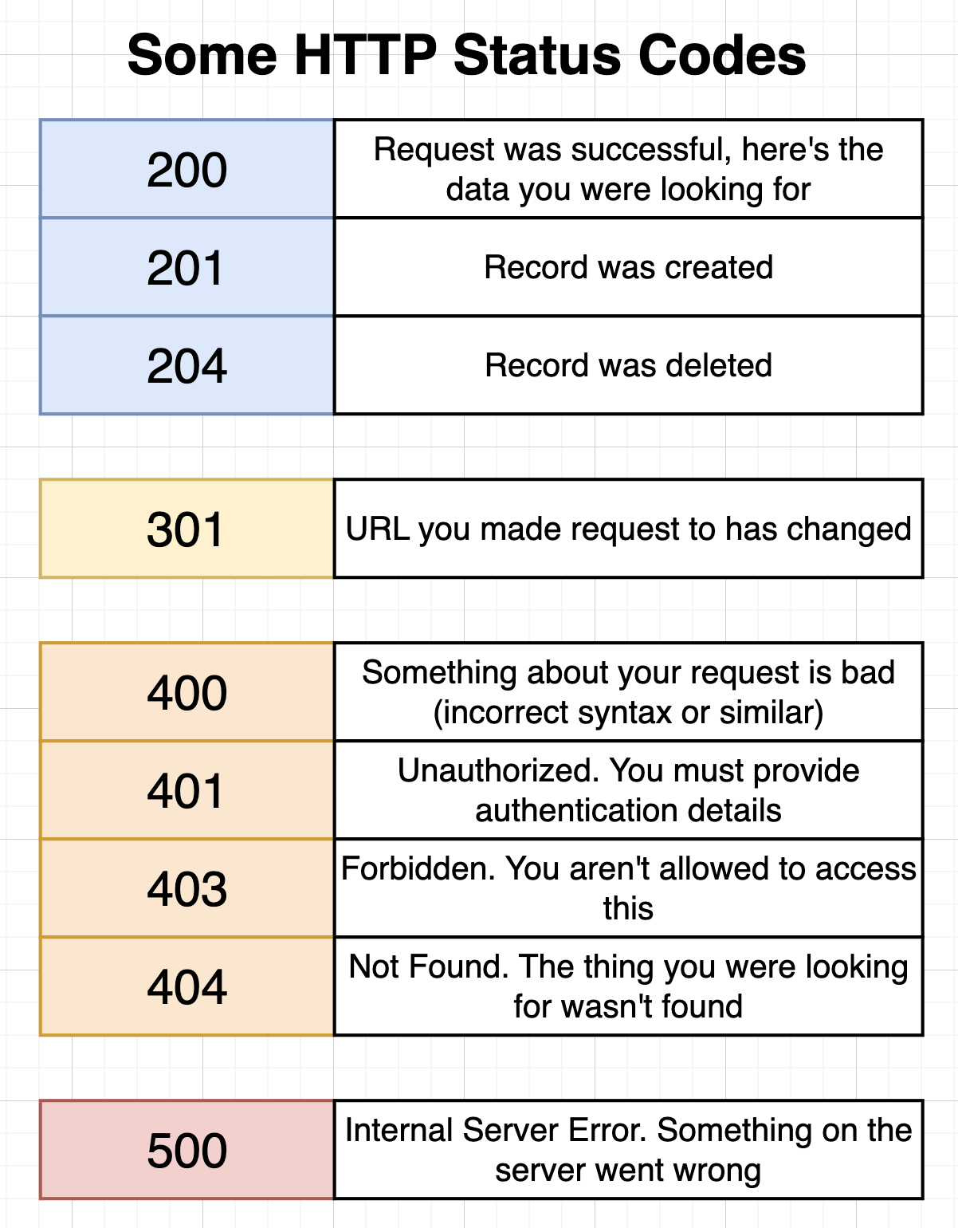

Slide 9
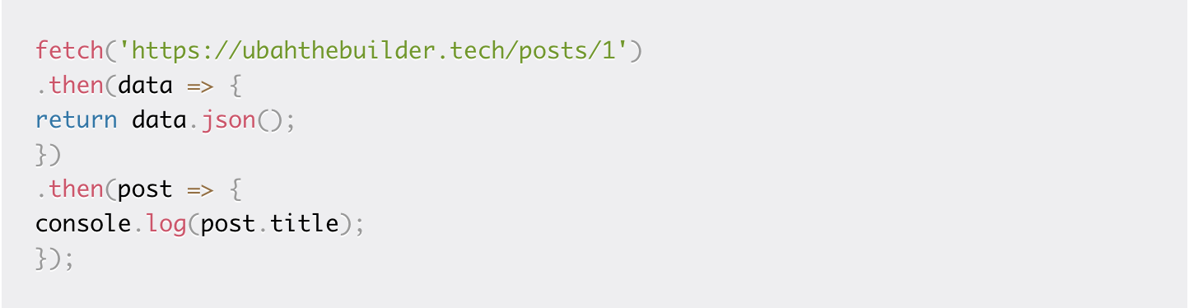
GET Request

Slide 10
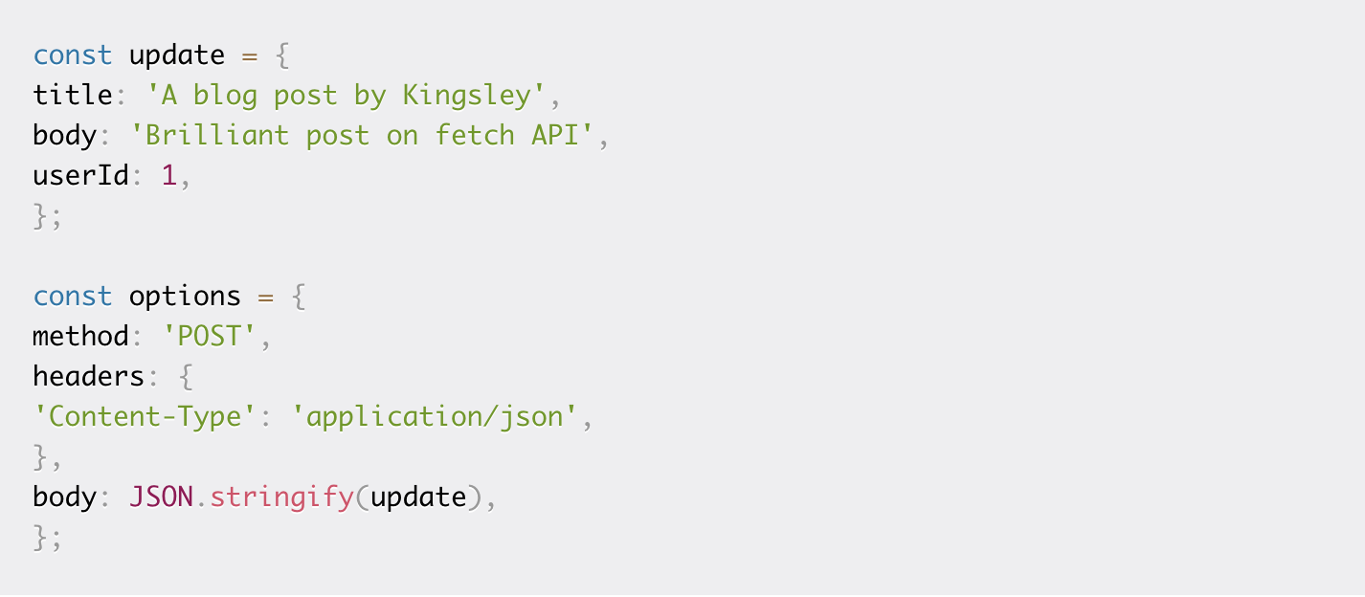
POST Request body

Slide 11
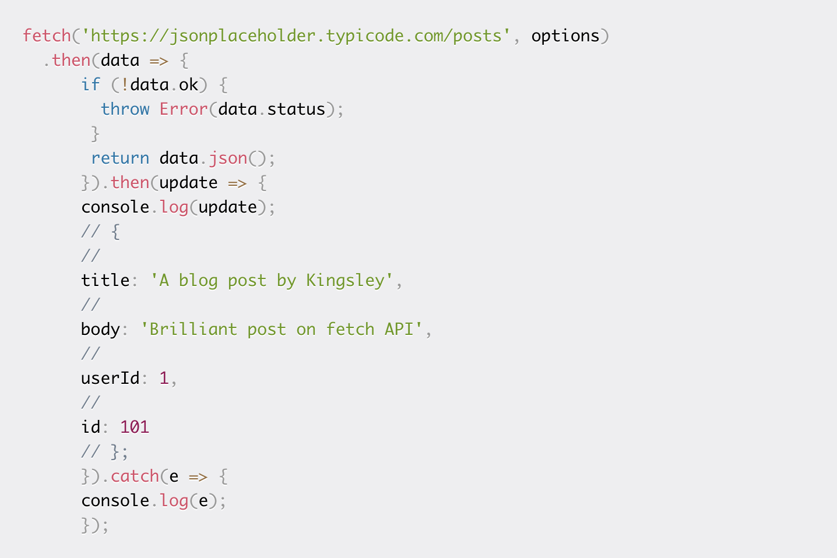
POST Request

Slide 12
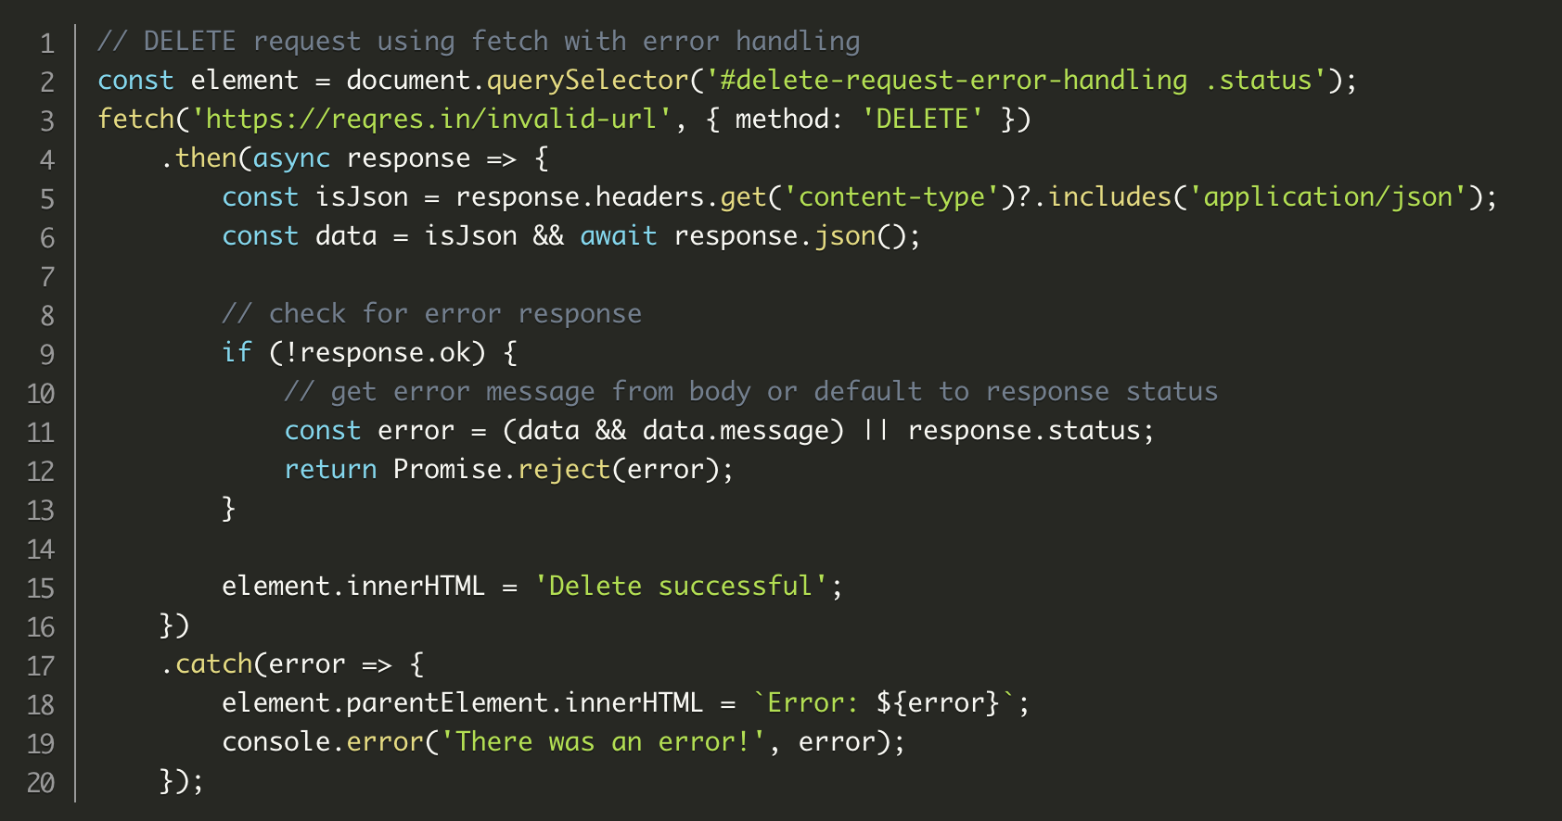
DELETE Request

Slide 13
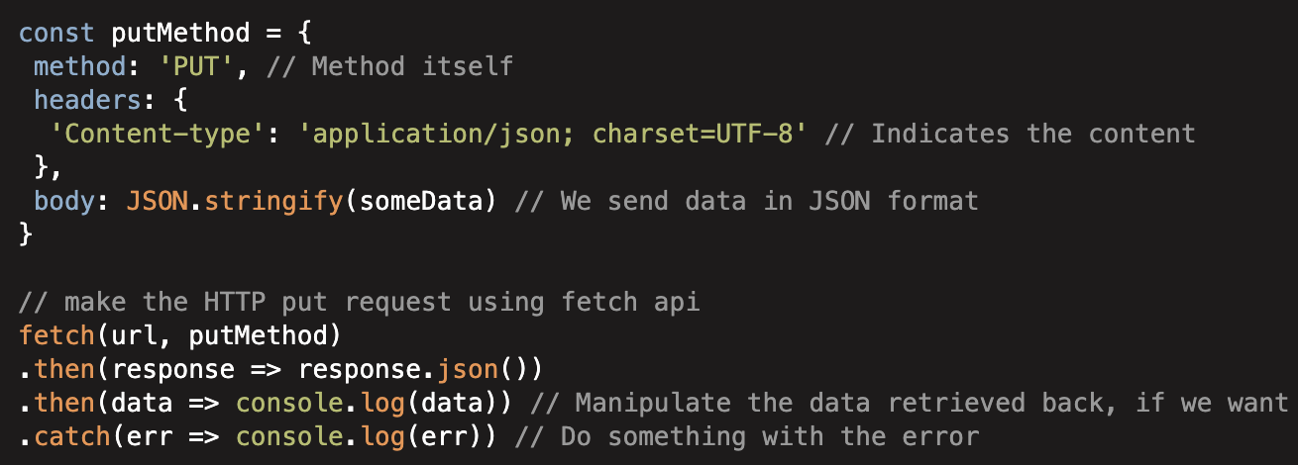
PUT Request

Slide 14
Examples using Axios library
https://www.freecodecamp.org/news/how-to-use-axios-with-react/

Slide 15
Inspect menu Examples
https://app.at.farm/farms
Let’s also see sh-ktr-mobile code

Slide 16
Communication using Context System

Slide 17
React Context
React Context is a way to manage state globally.
It can be used together with the useState Hook to share state between deeply nested components more easily than with useState alone.

Slide 18
Other Hooks

Slide 19
Other Hooks
useRef
useReducer
useCallback
useMemo
Custom Hooks

Slide 20
React Context and Hooks Example
https://www.w3schools.com/react/react_usecontext.asp

Slide 21
Dive into Redux Toolkit

Slide 22
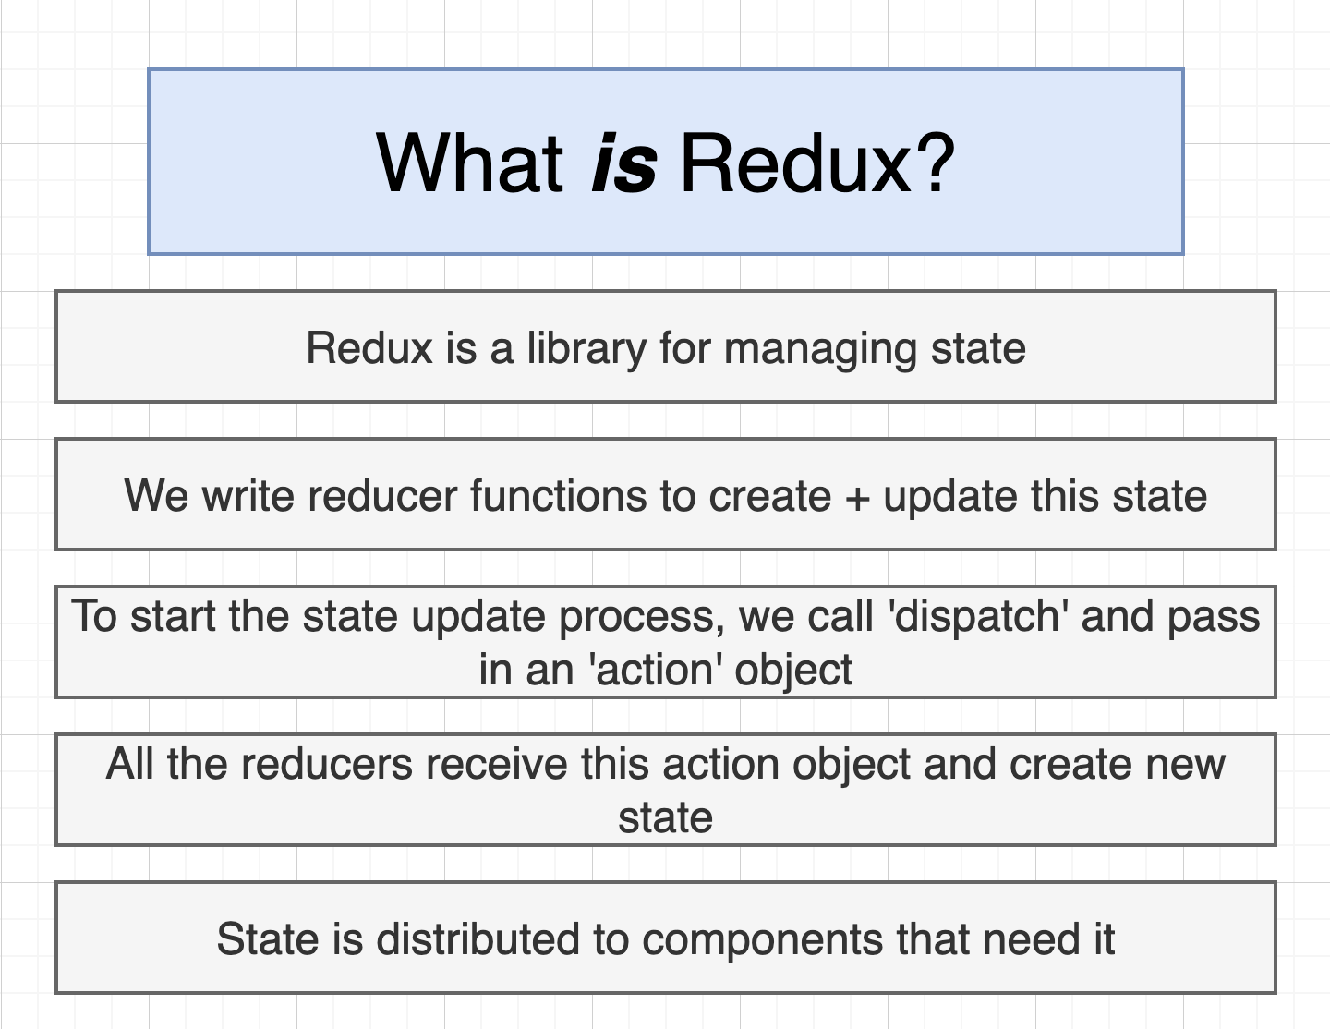

Slide 23
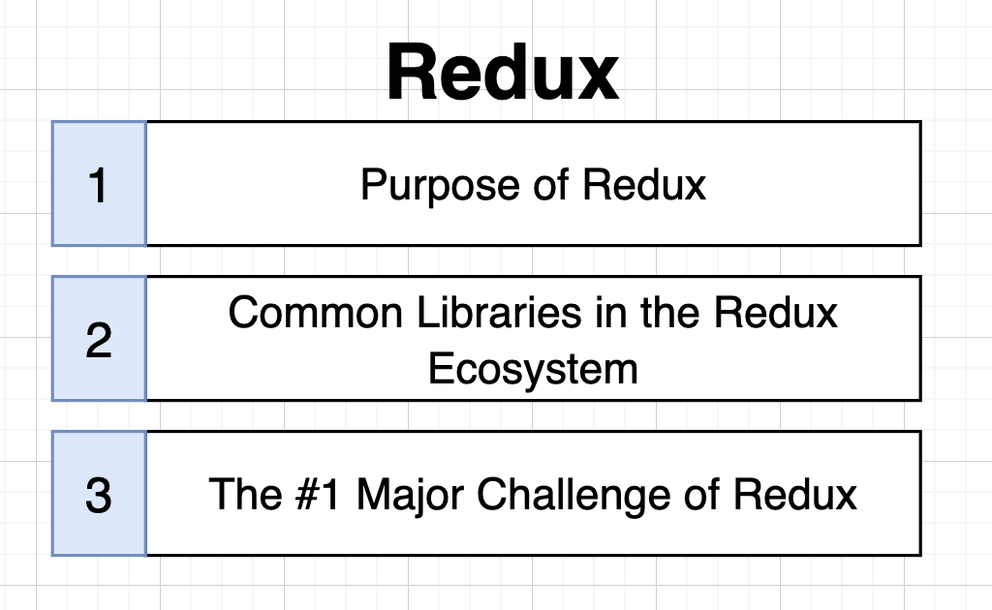

Slide 24
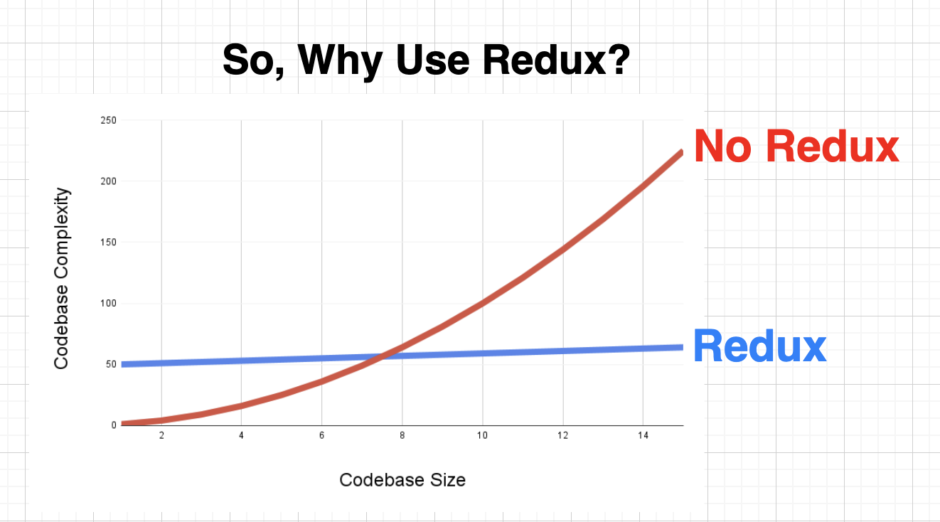

Slide 25
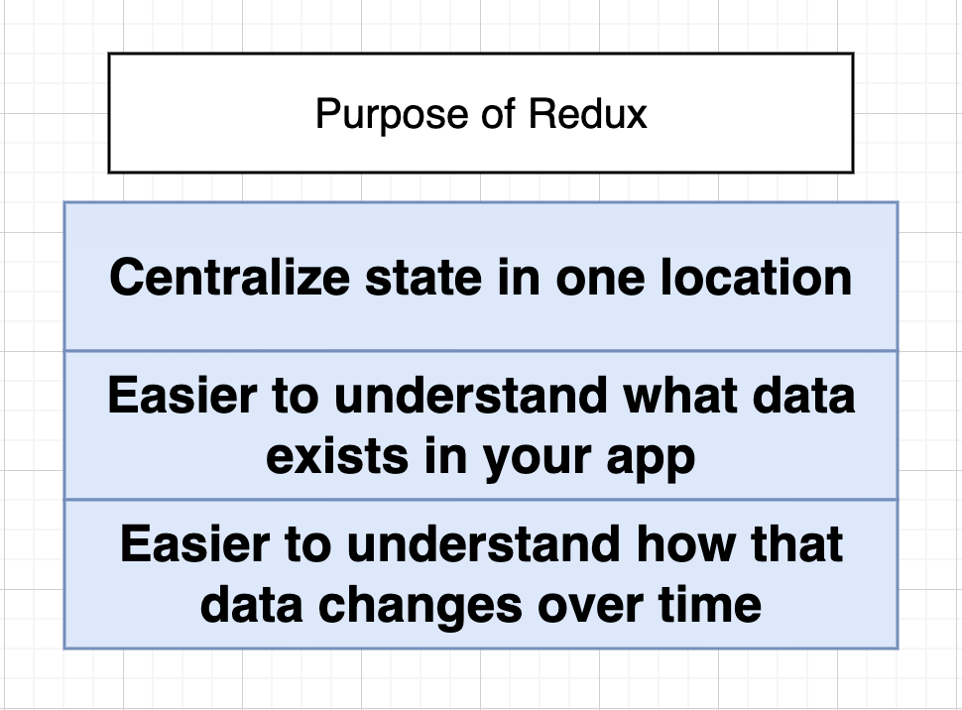

Slide 26
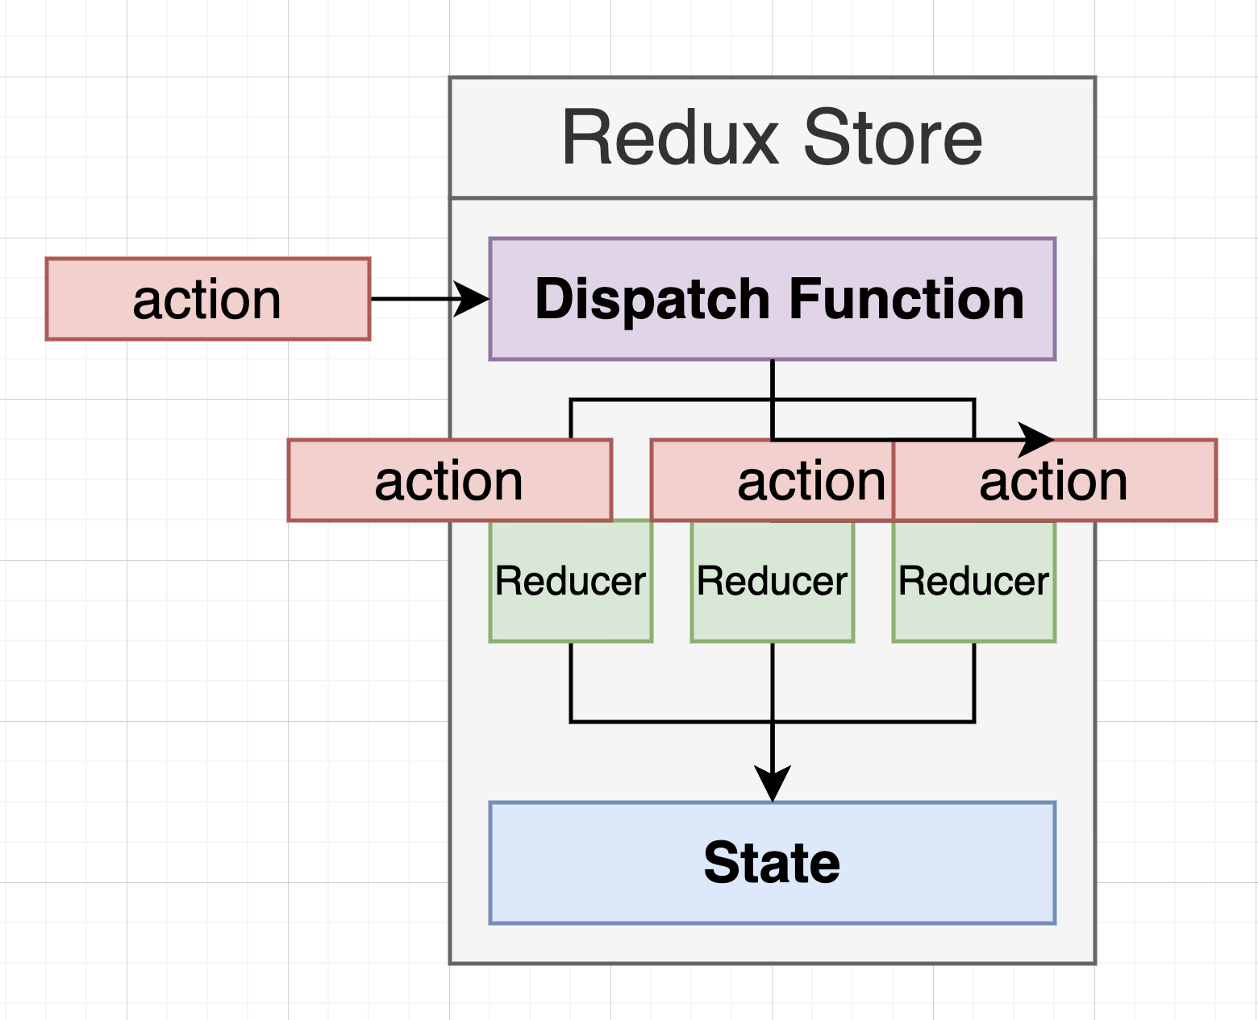

Slide 27
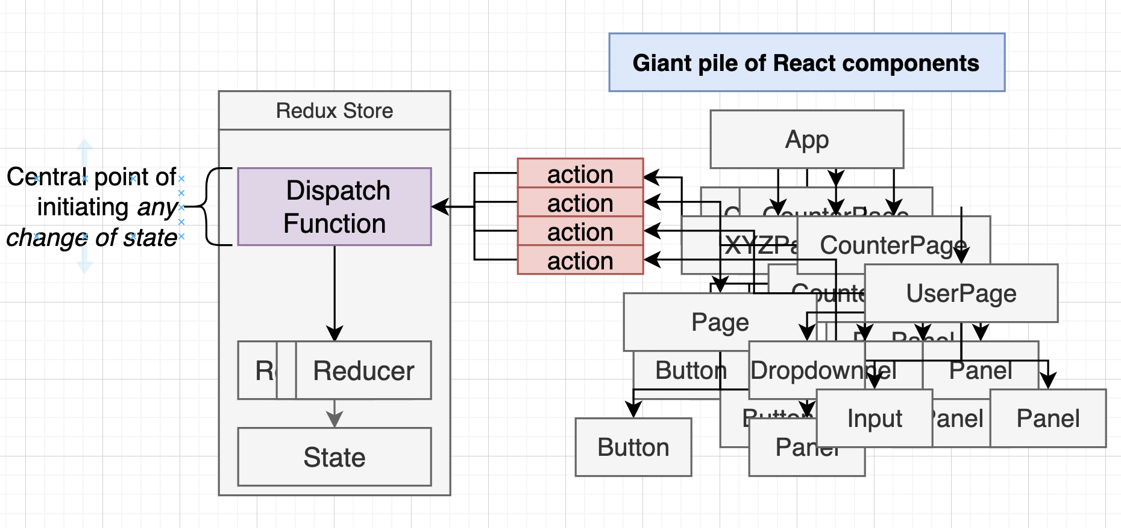

Slide 28
Redux Toolkit Basic Steps
Create your slices
configureStore
Connect redux with react using react-redux
Ready for using redux

Slide 29
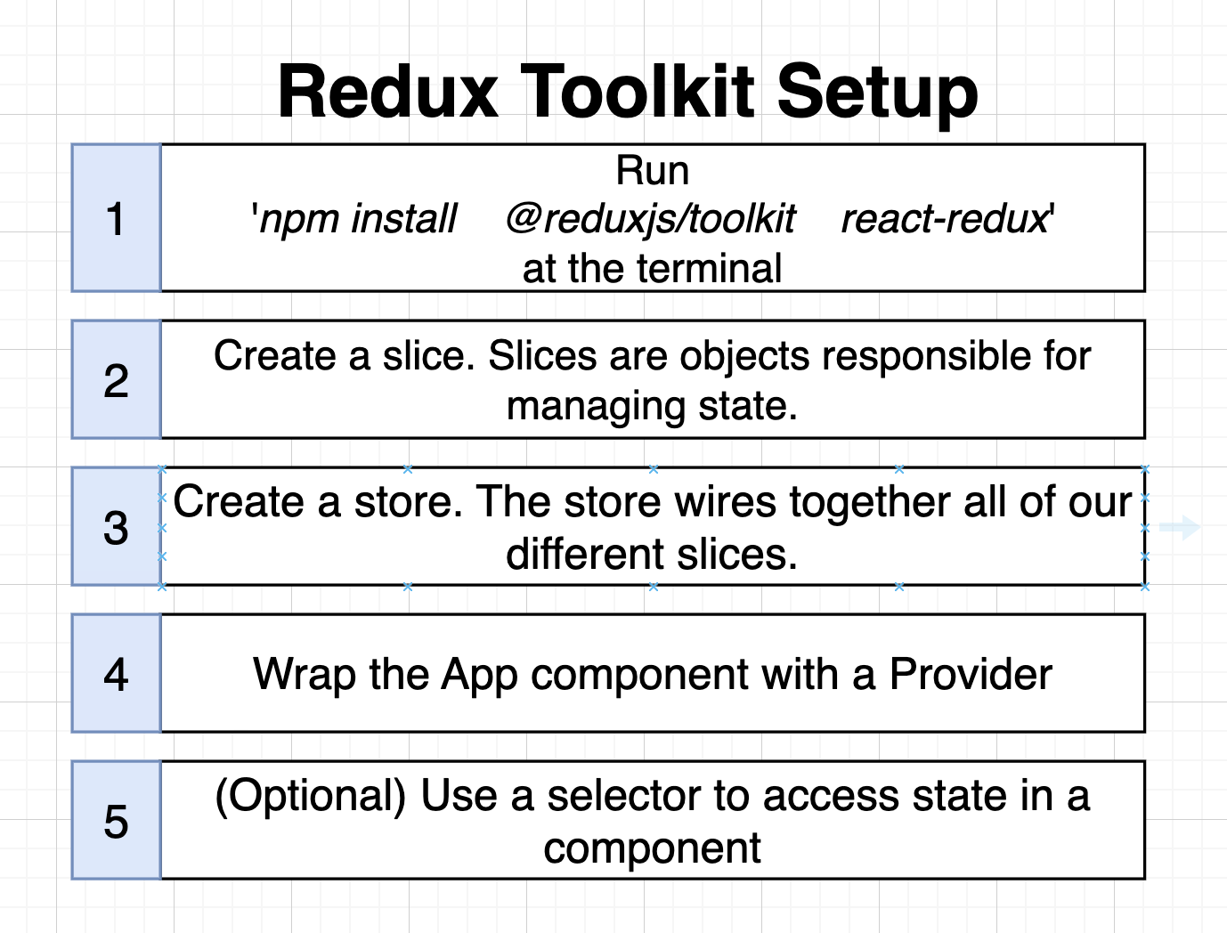

Slide 30
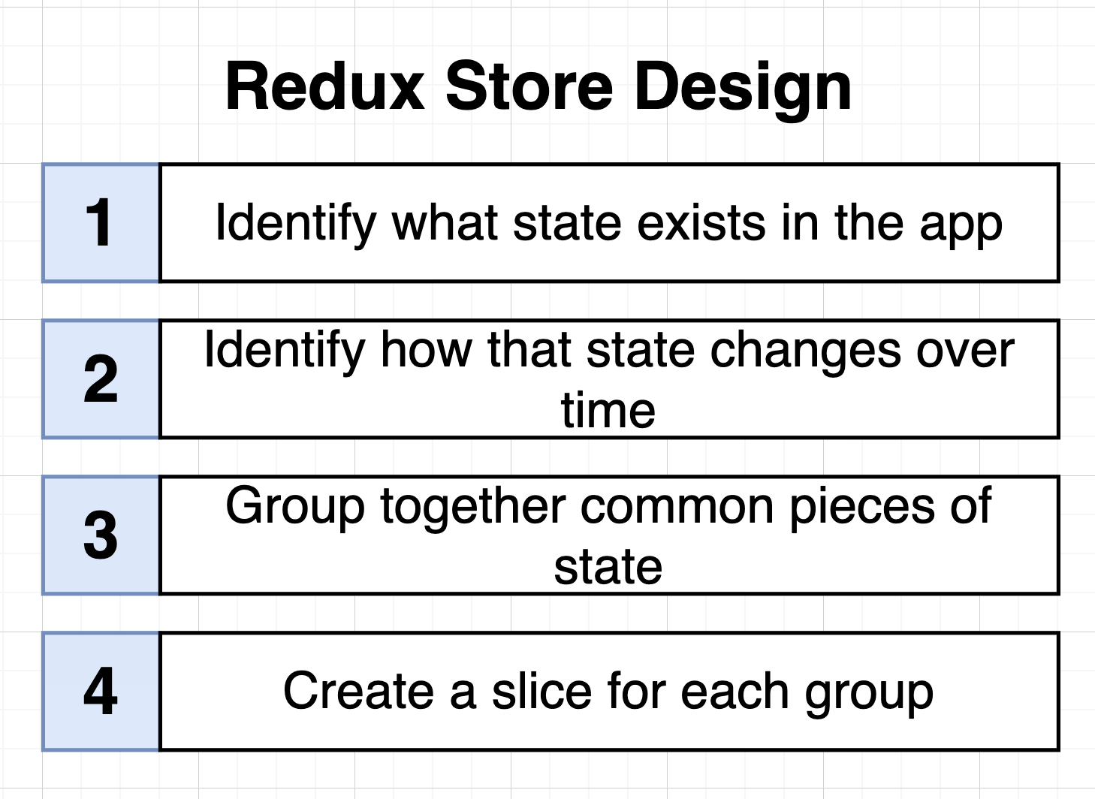

Slide 31
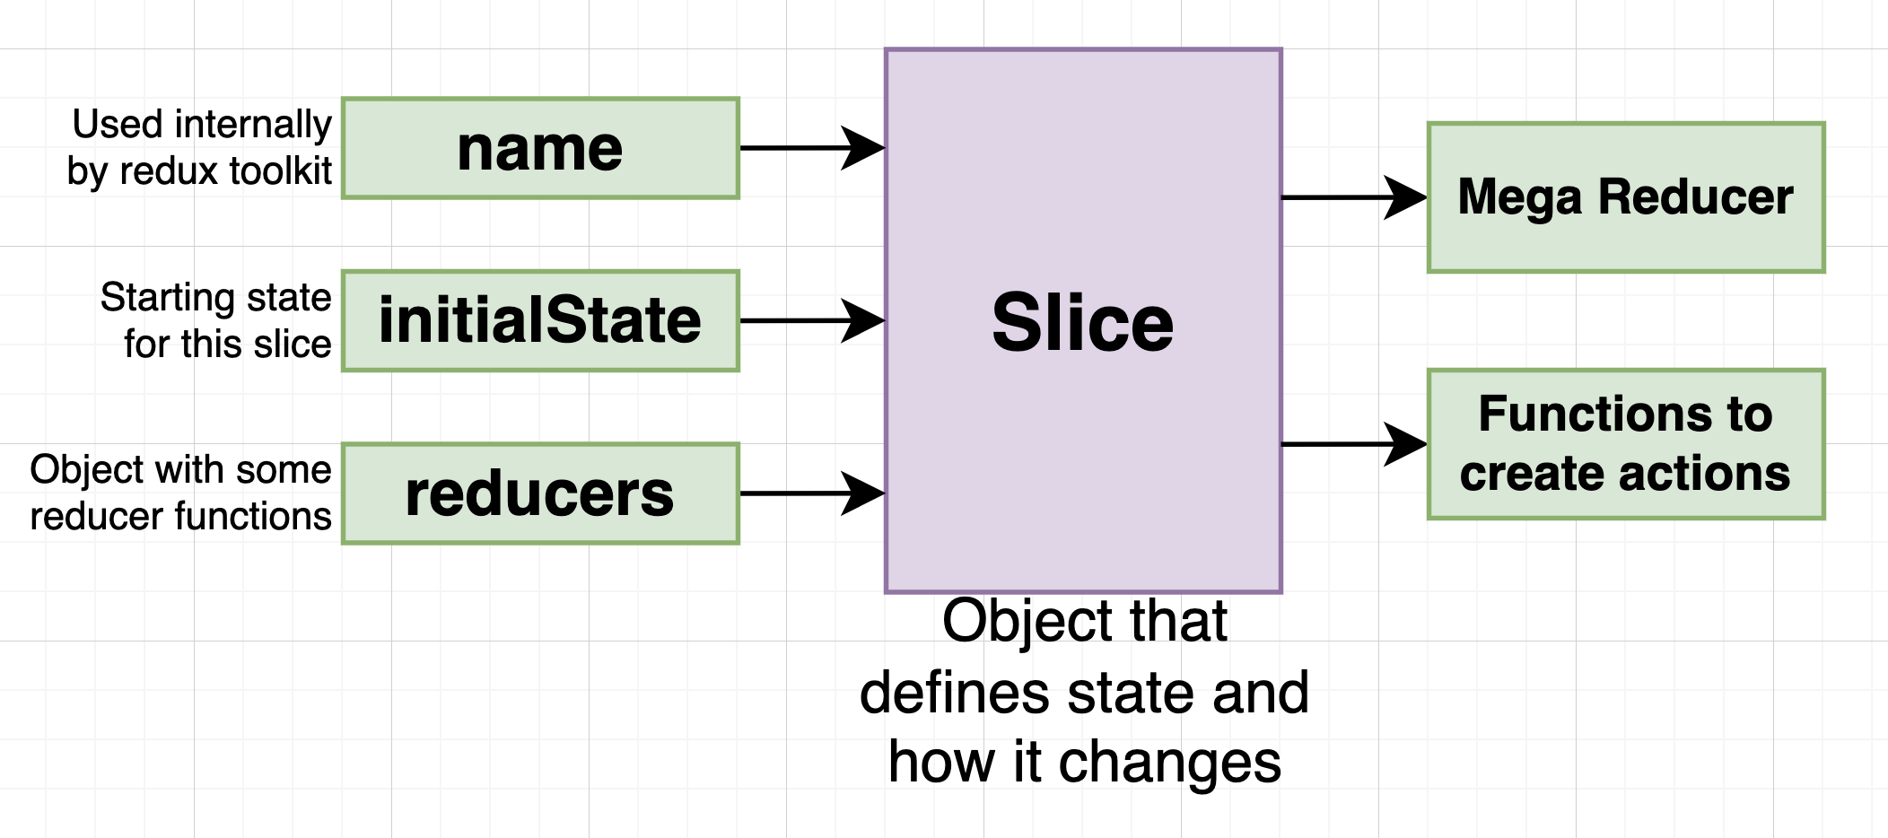

Slide 32
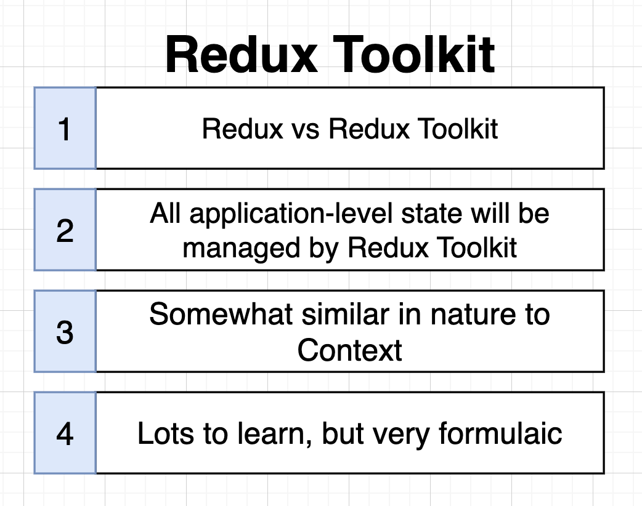
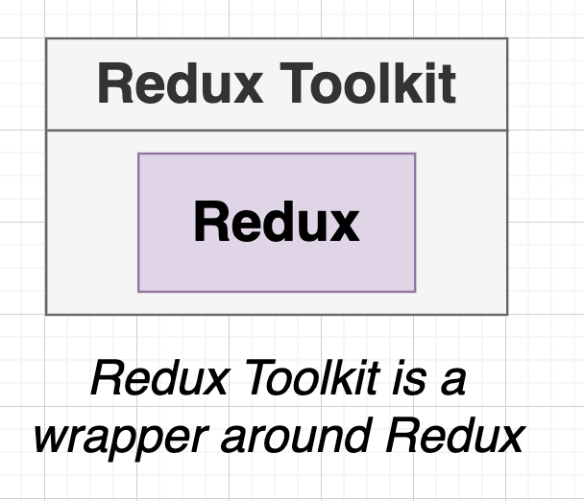

Slide 33
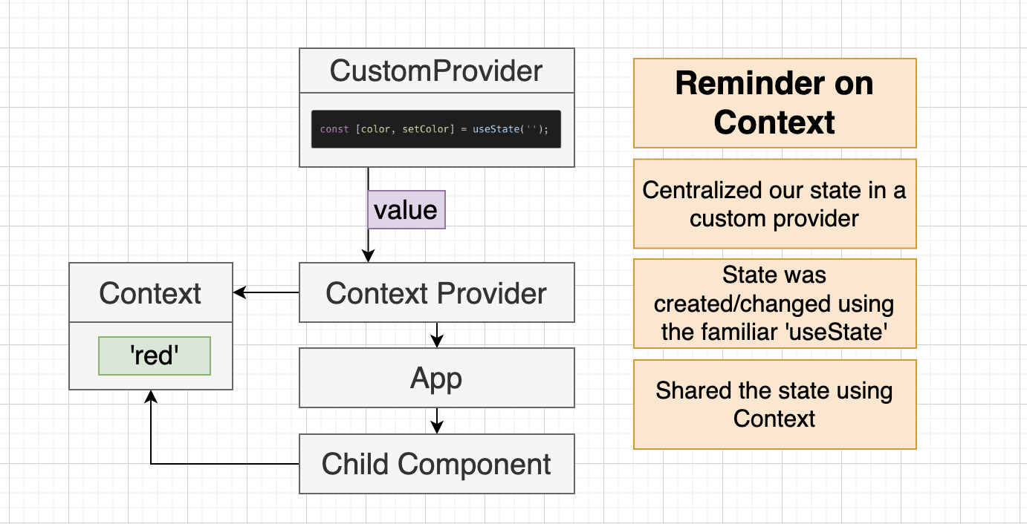

Slide 34
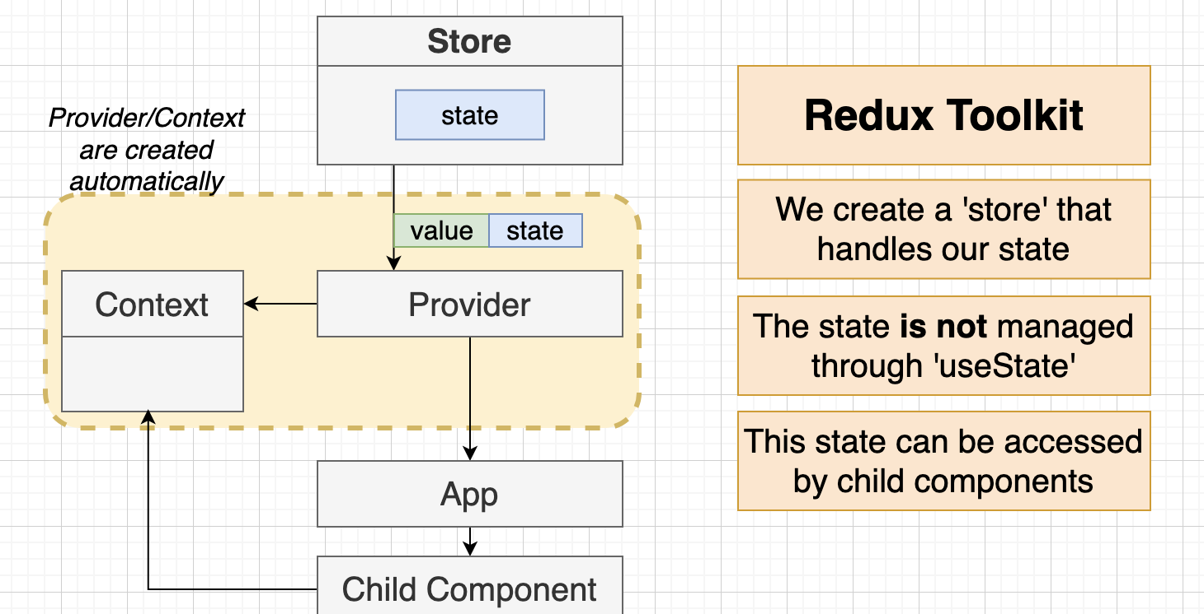

Slide 35
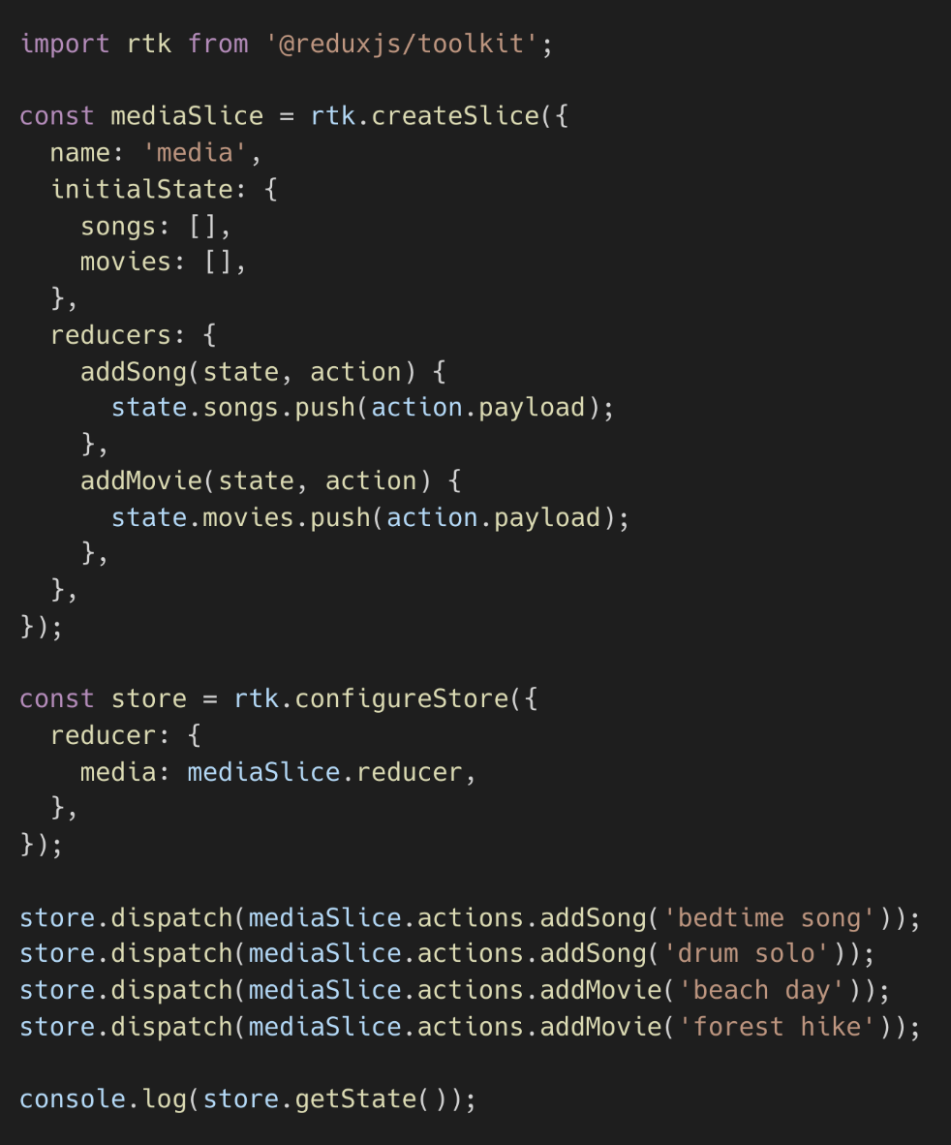

Slide 36
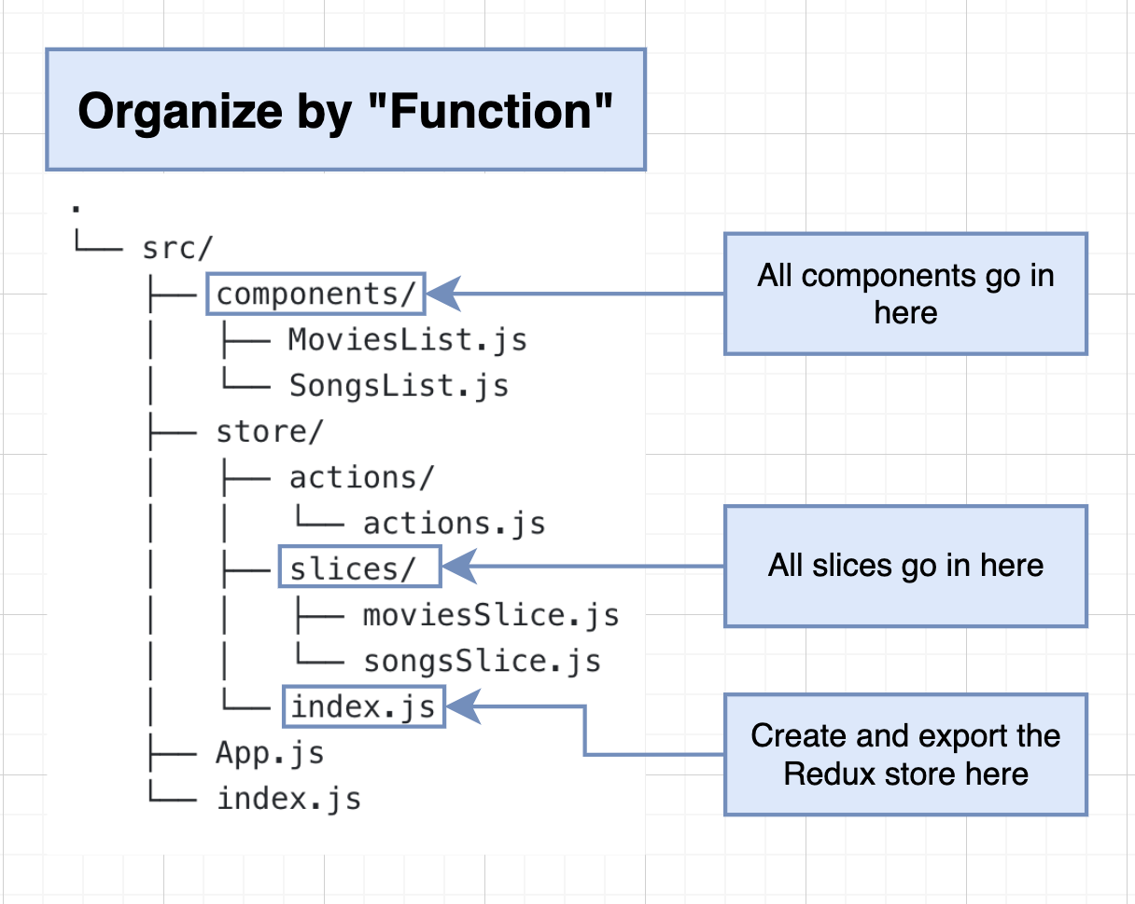

Slide 37
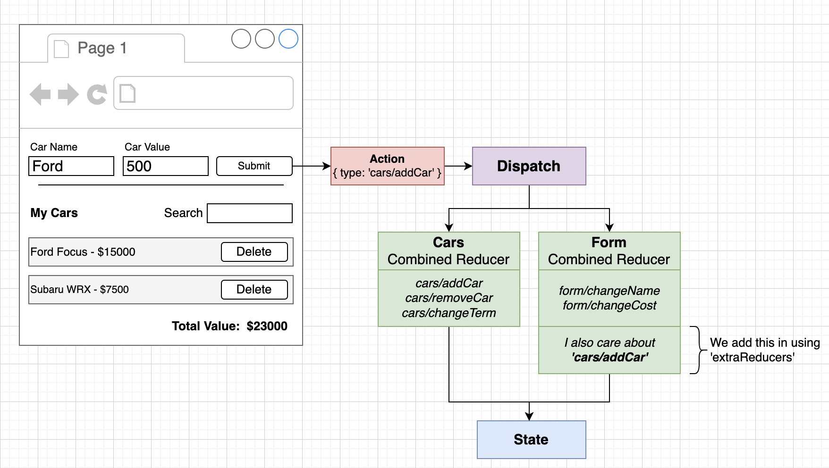

Slide 38
Using Redux Toolkit Query

Slide 39
Two ways of data fetching
1. Async Thunk Functions (fetch users)
2. Redux Toolkit Query (handle albums and photos)
Usually, we use one of them in a project. 2nd is a newer and recommended way.

Slide 40
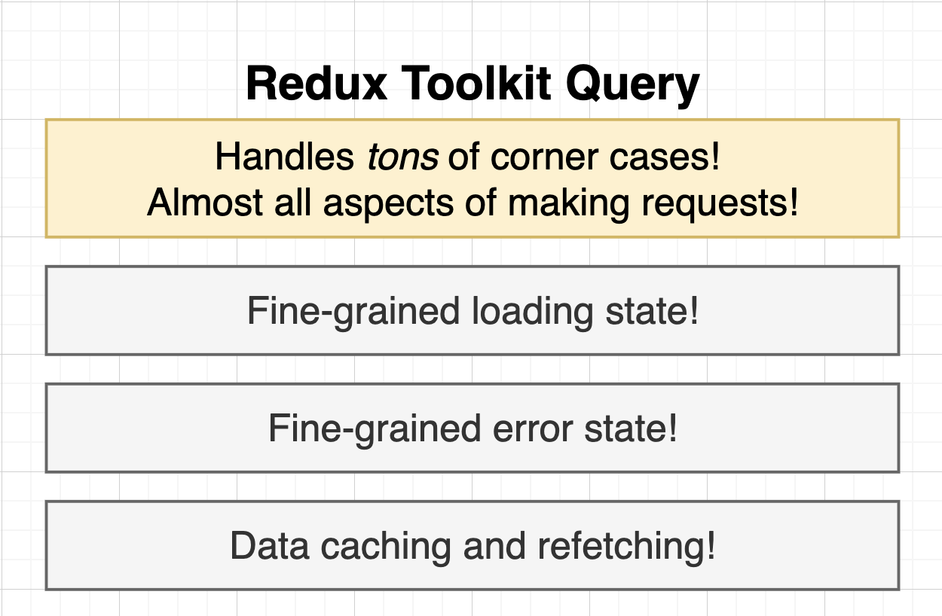

Slide 41
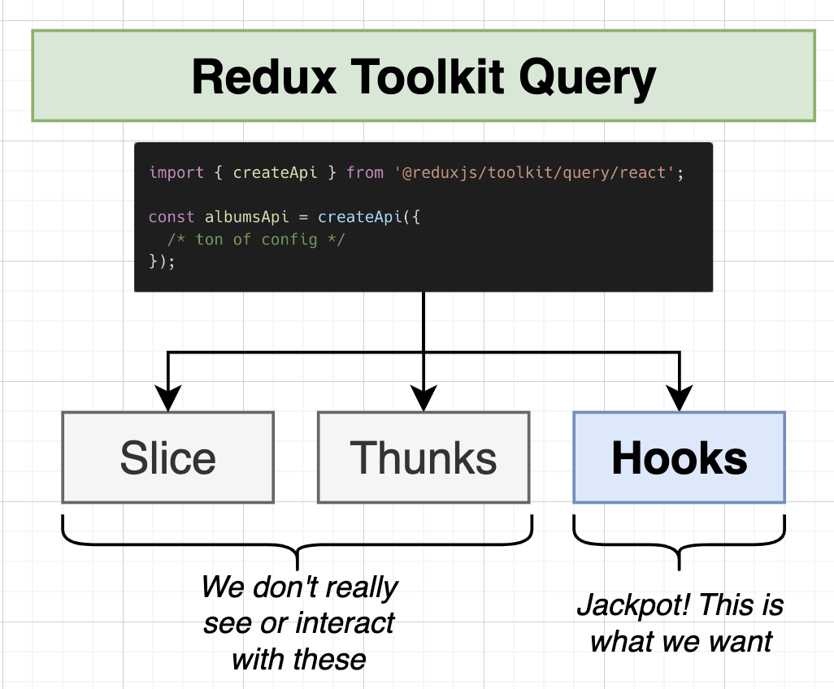

Slide 42
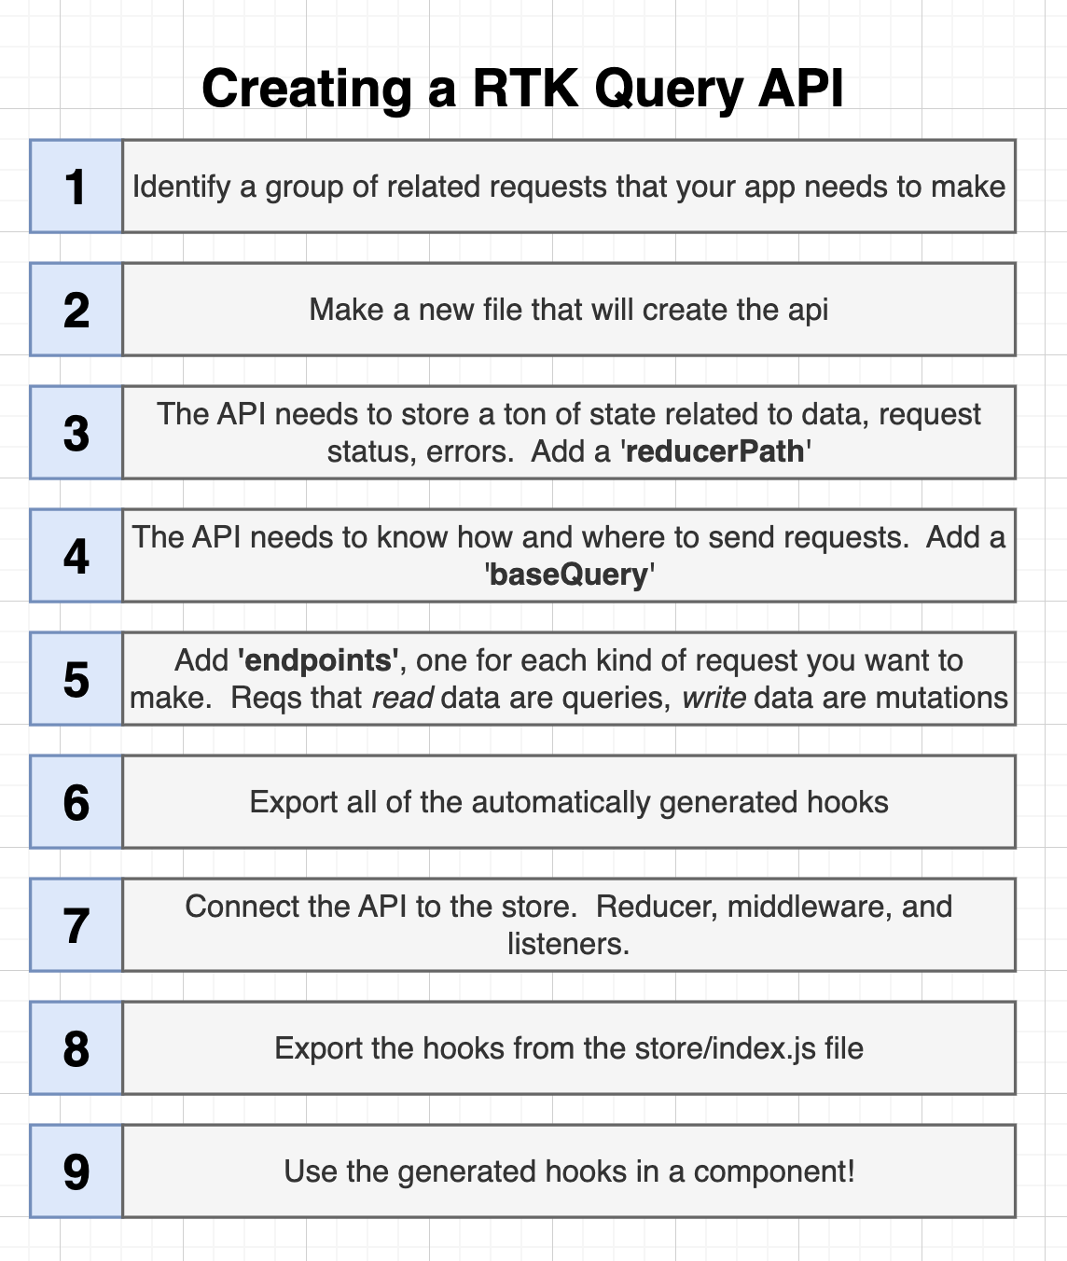

Slide 43
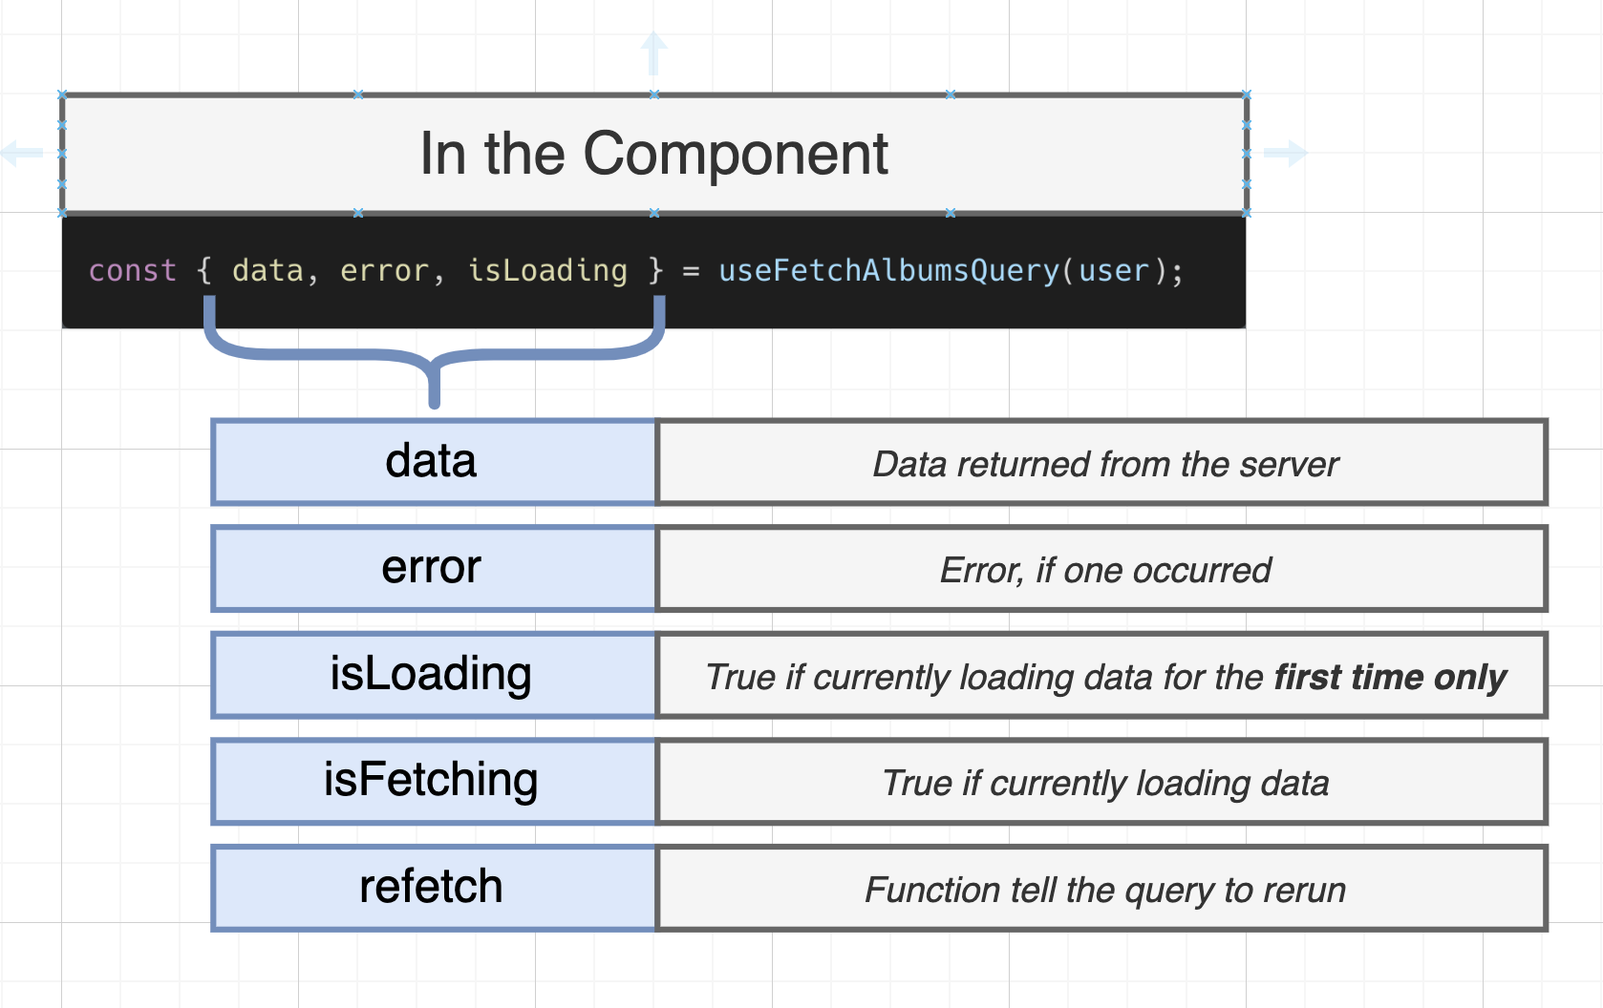

Slide 44
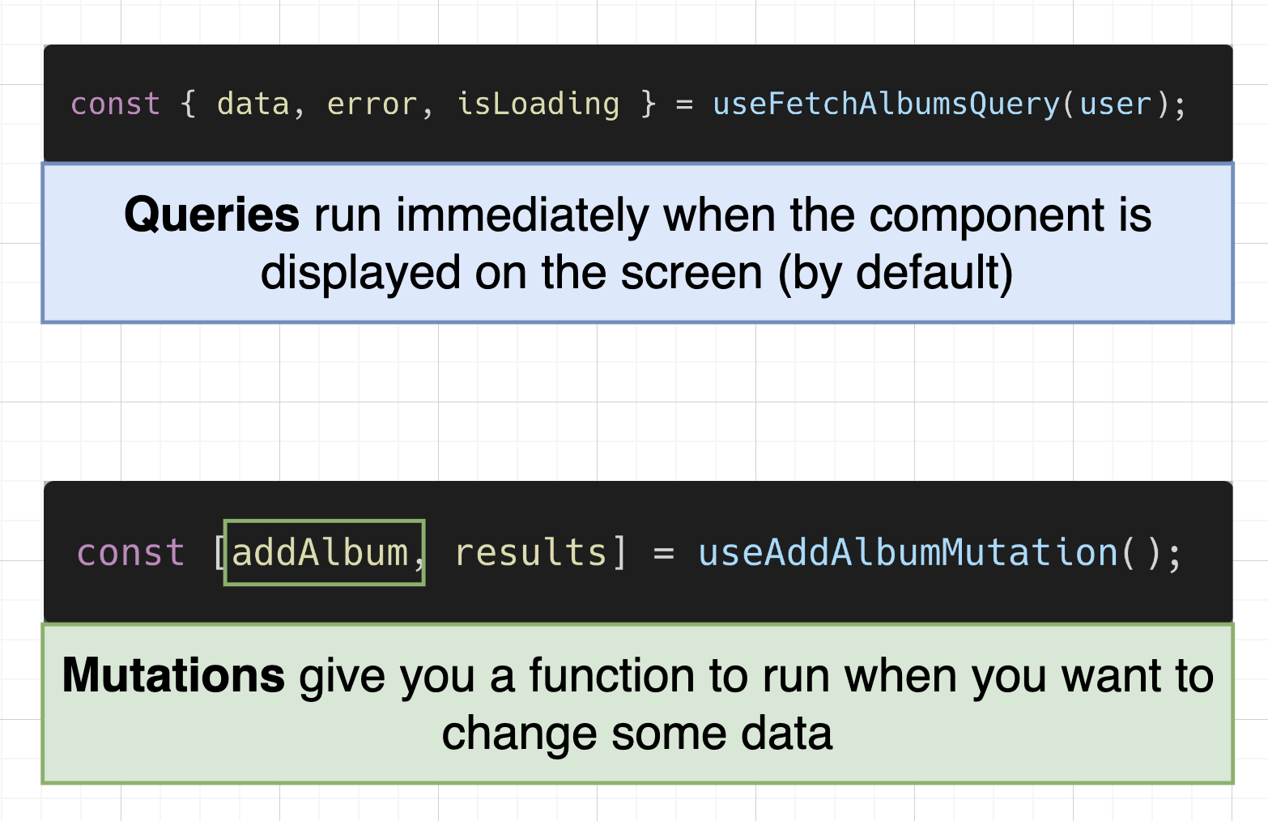

Slide 45
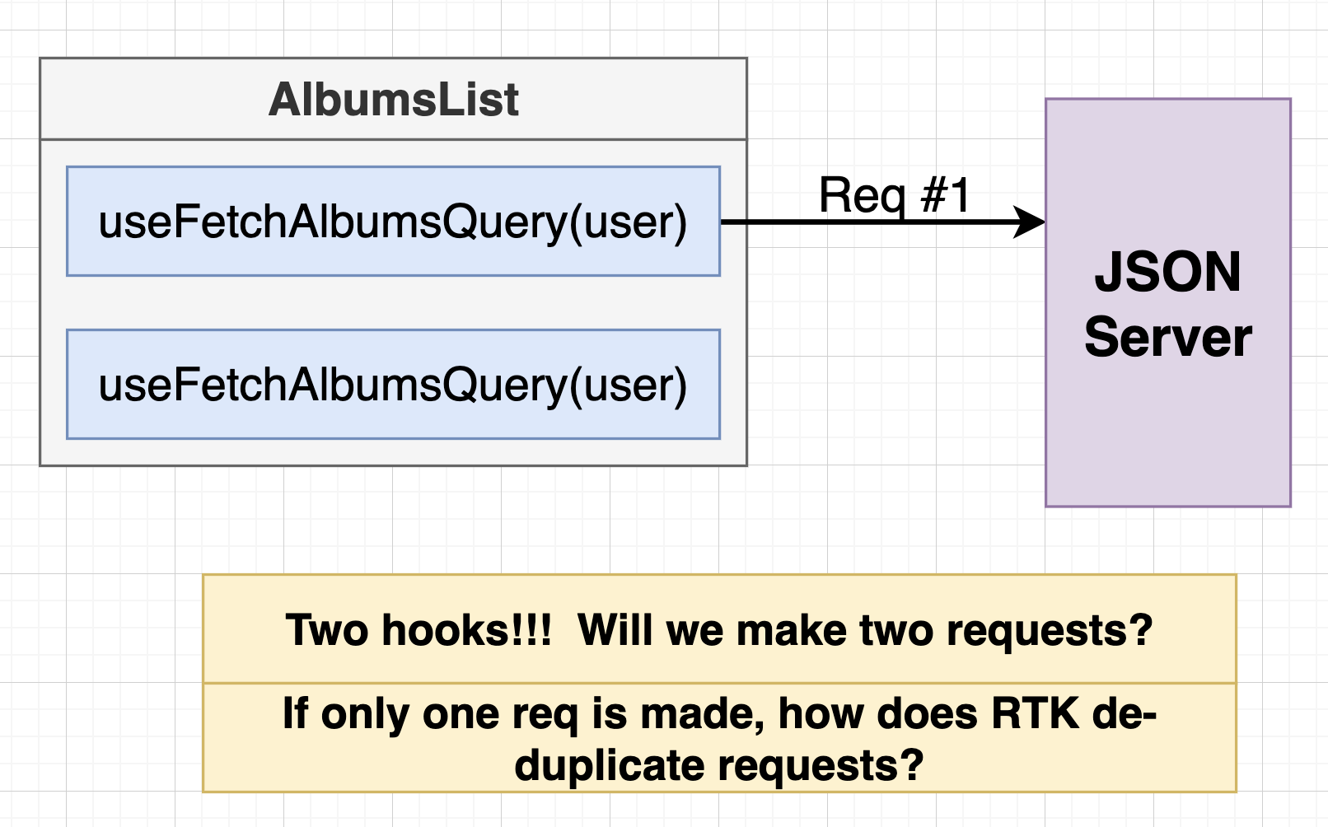

Slide 46
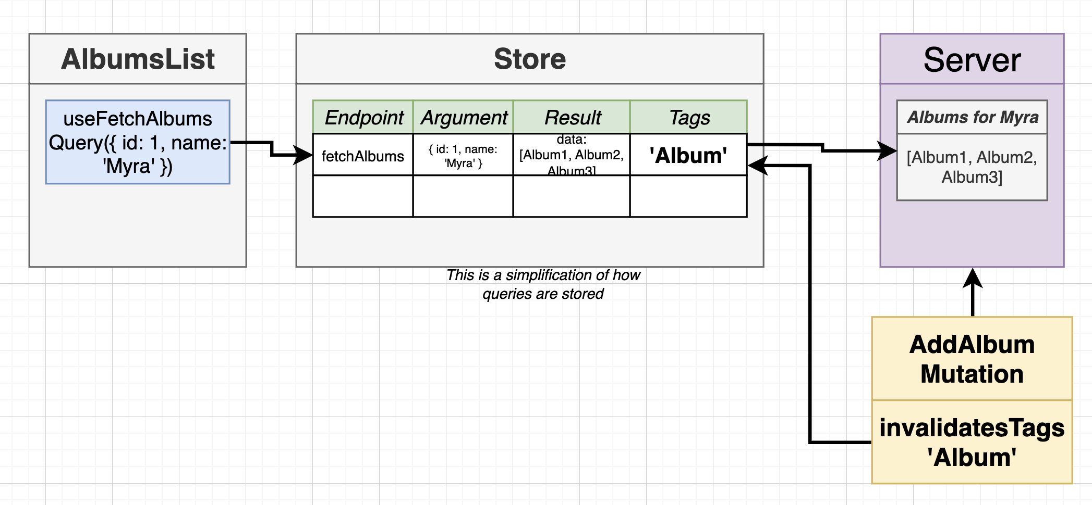

Slide 47
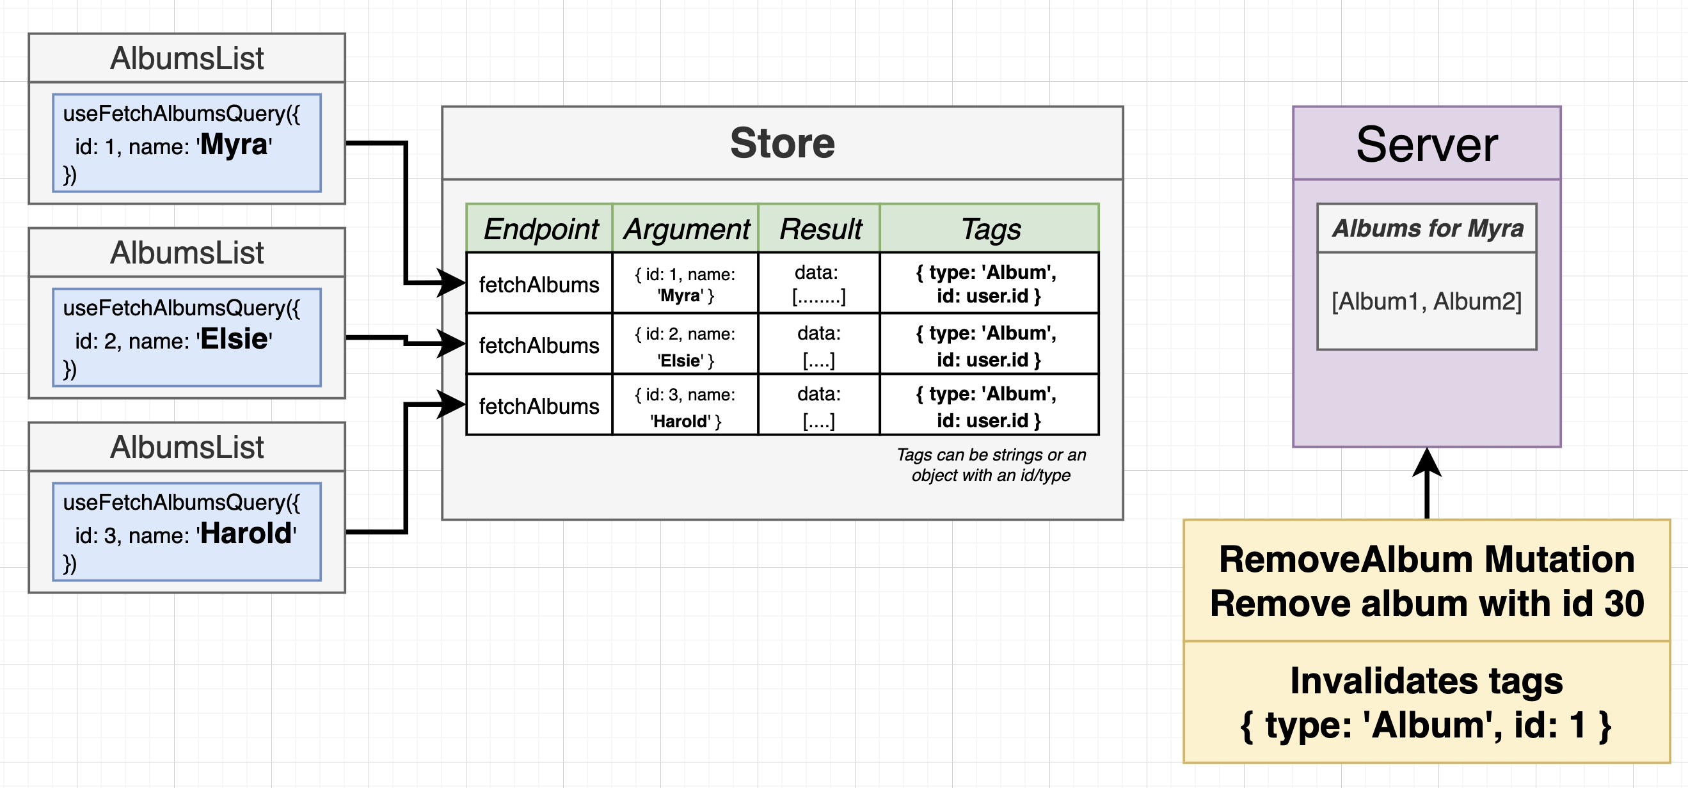

Slide 48
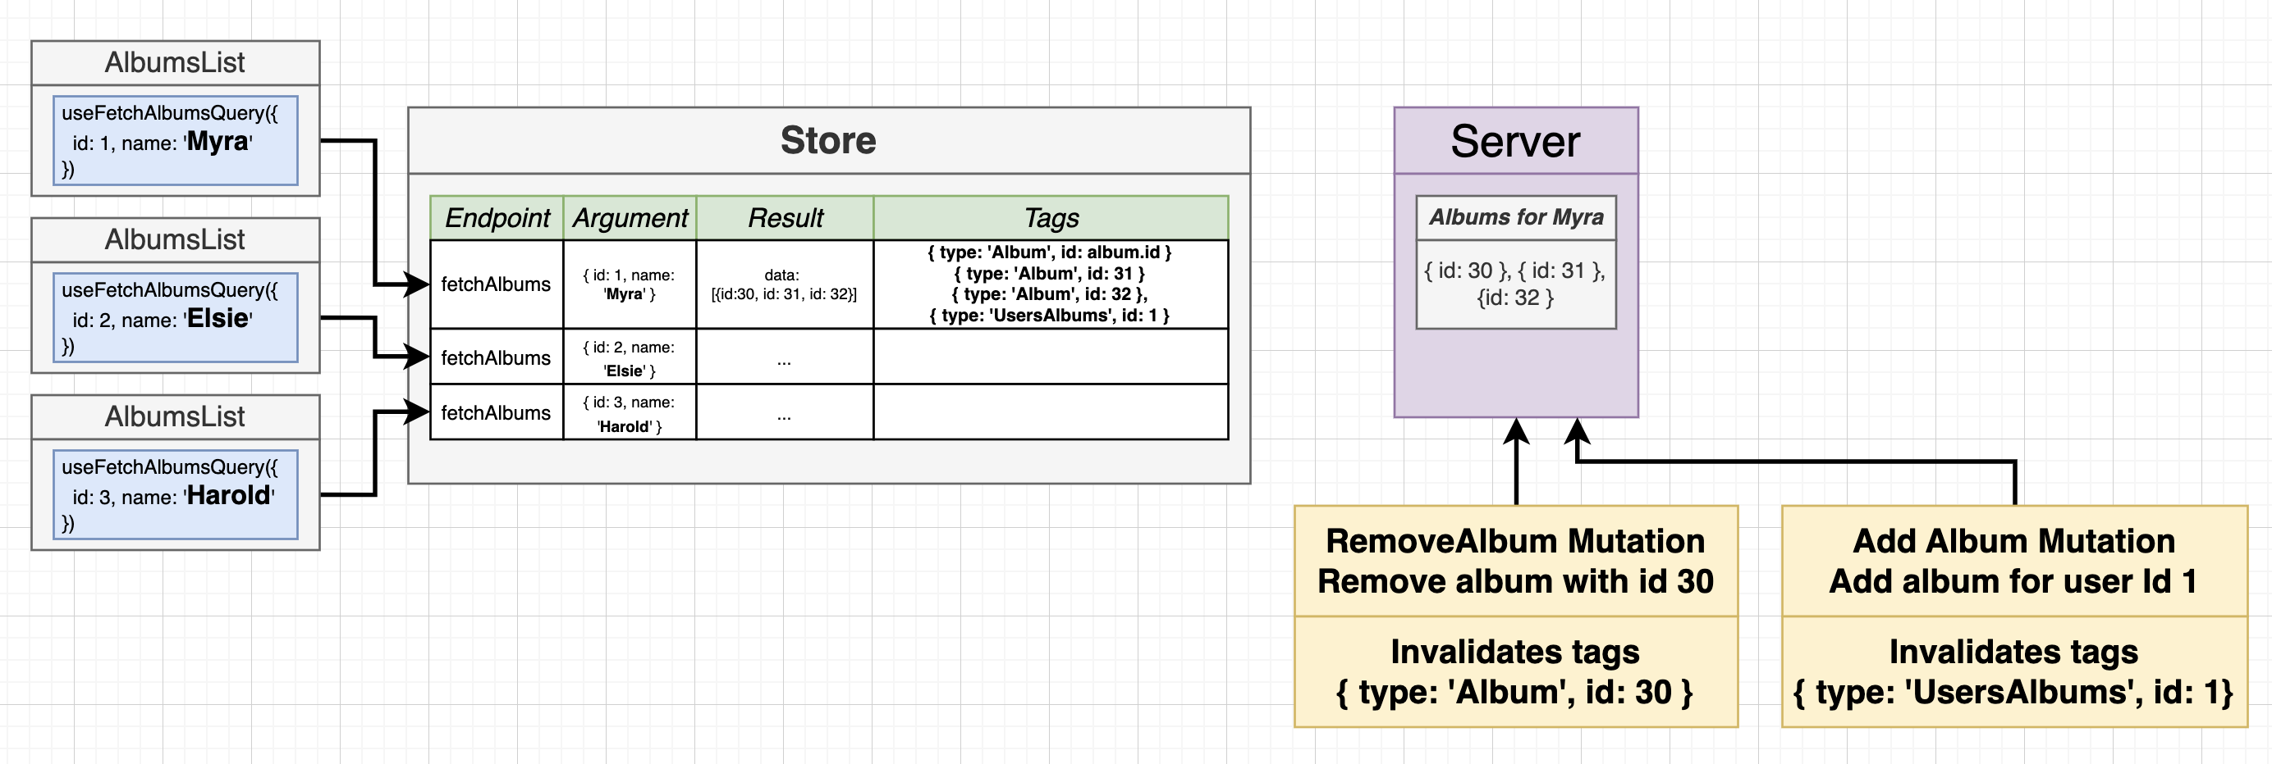

Slide 49
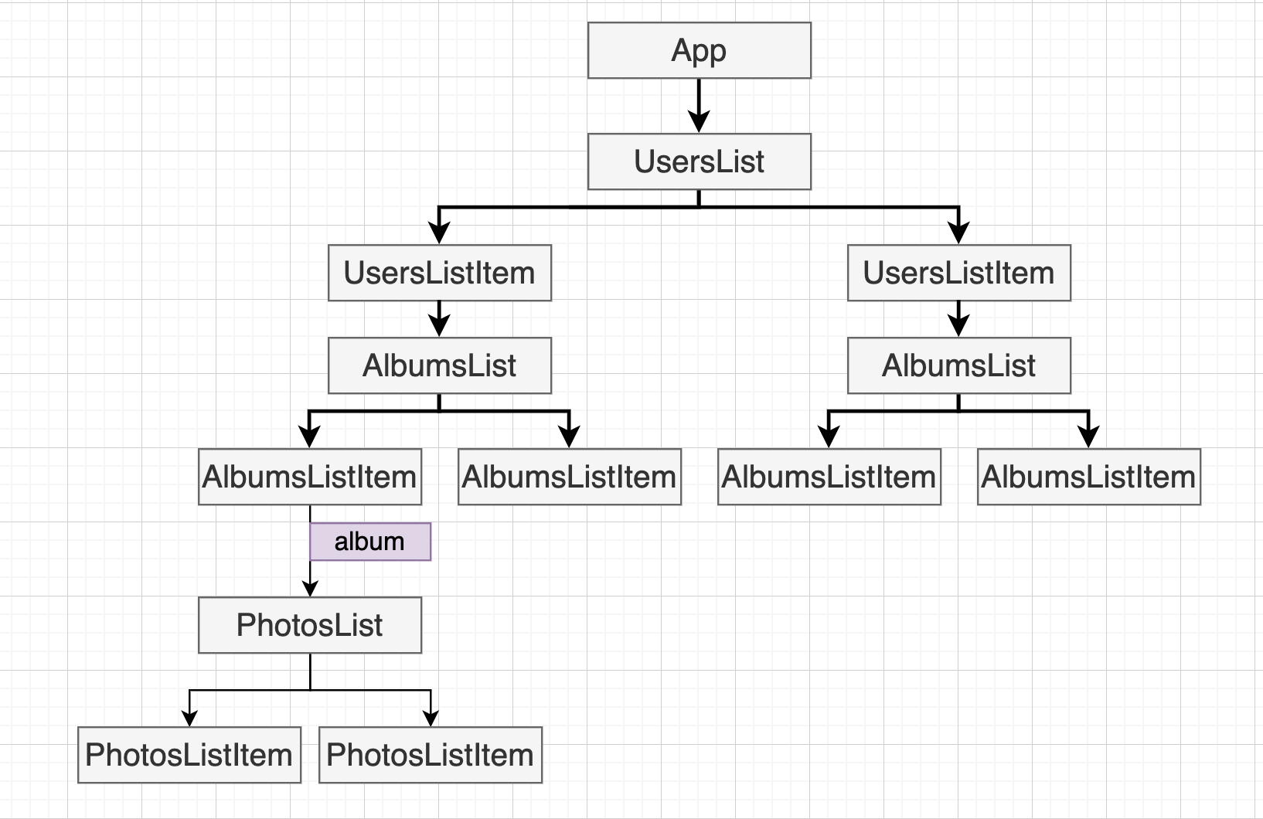

Slide 50
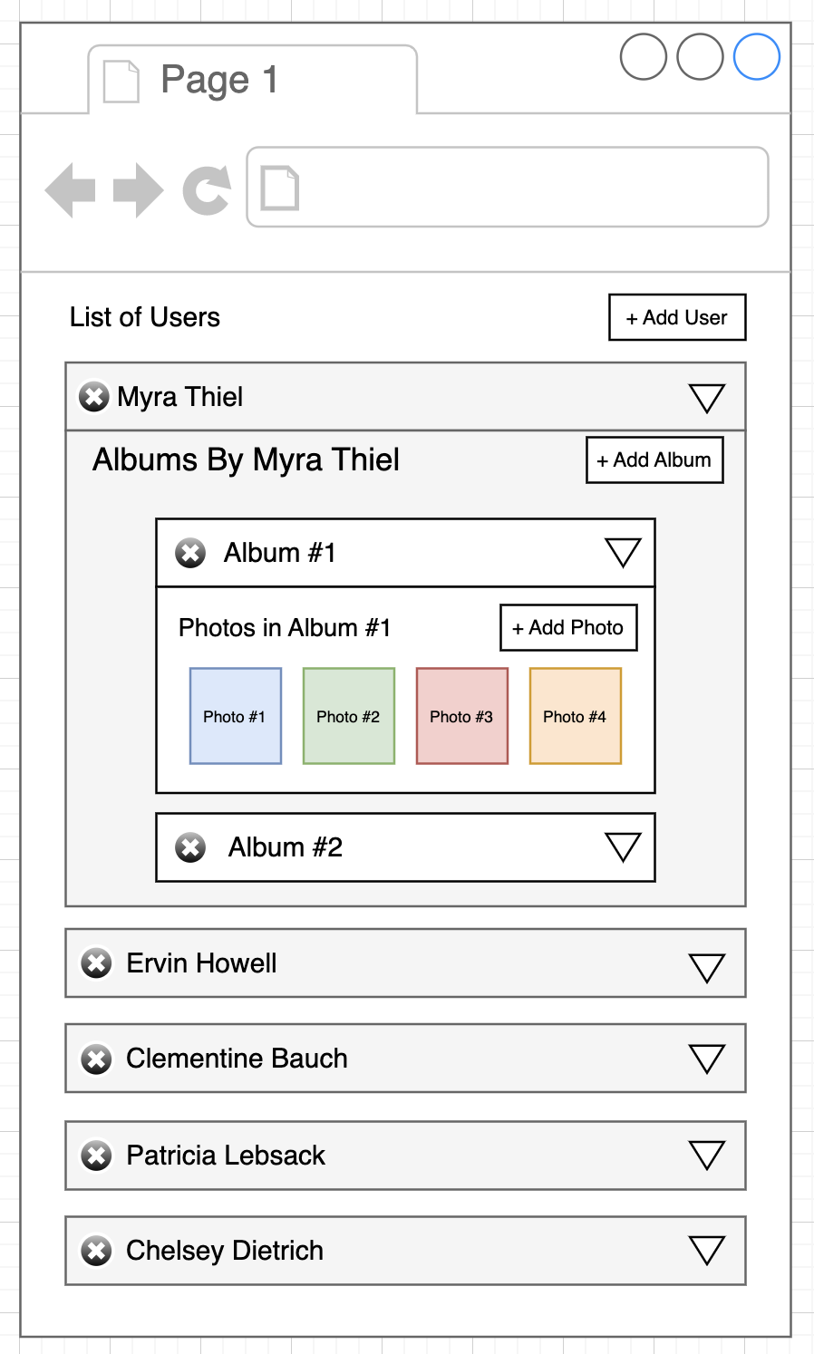

Slide 51
Questions
Pravesh Choudhary
Tech Lead @ Yara AgCap

